Slide 1
Green Box

Slide 2
Ingredients
Arduino Nano
Voltage Sensor
MQ-1 (Gas Sensor)
Sharp GP2Y1010AU0F
NodeMCU8266
Bosch BME280 (I2C)

Slide 3
Arduino Part

Slide 4
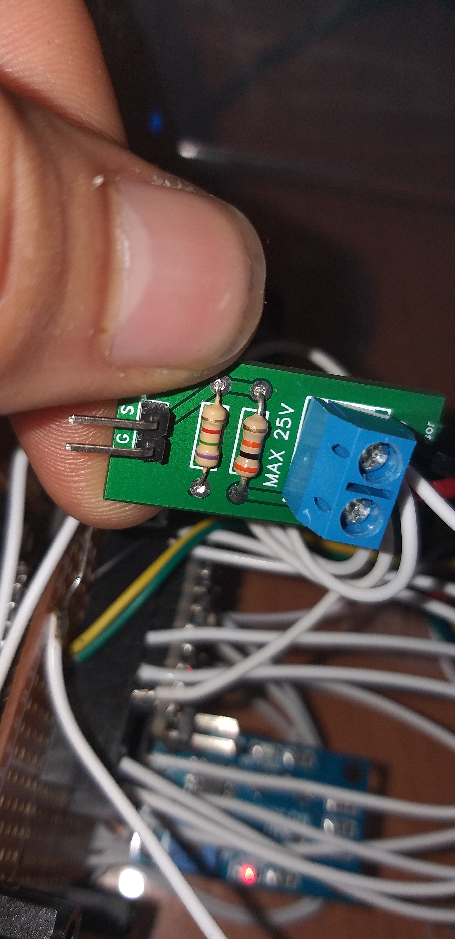
Voltage Sensor
Downscale the voltage for safely measuring

Slide 5
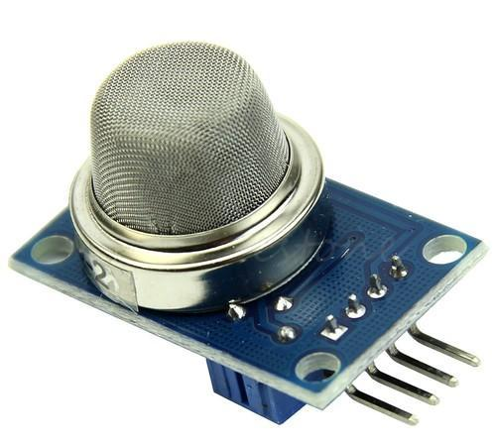
MQ-2
LPG
Carbon monoxide
Smoke

Slide 6
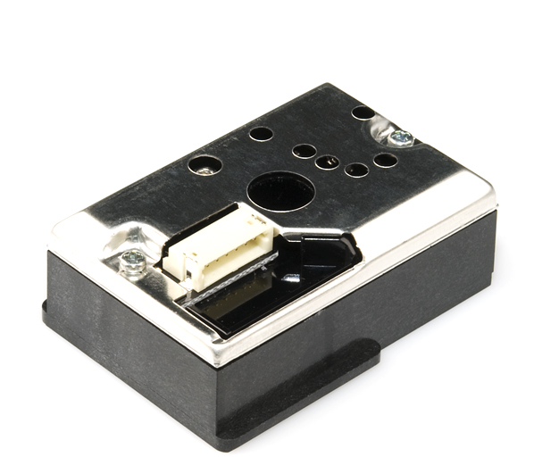
Sharp GP2Y1010AU0F
Dust Density Senor

Slide 7
NodeMCU8266

Slide 8
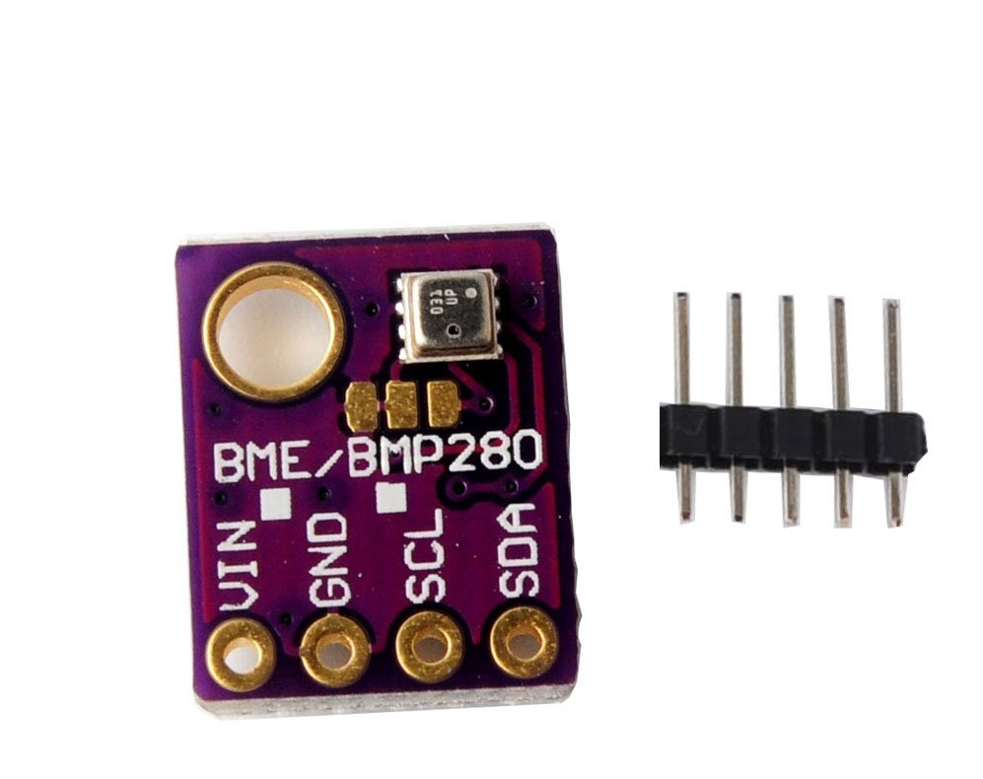
Bosch BME280
Temperature
Humidity
Altitude
Pressure

Slide 9
Arduino – 2 – NodeMCE826
Software Serial Transmit
Software Serial Receive
WiFi Server

Slide 10
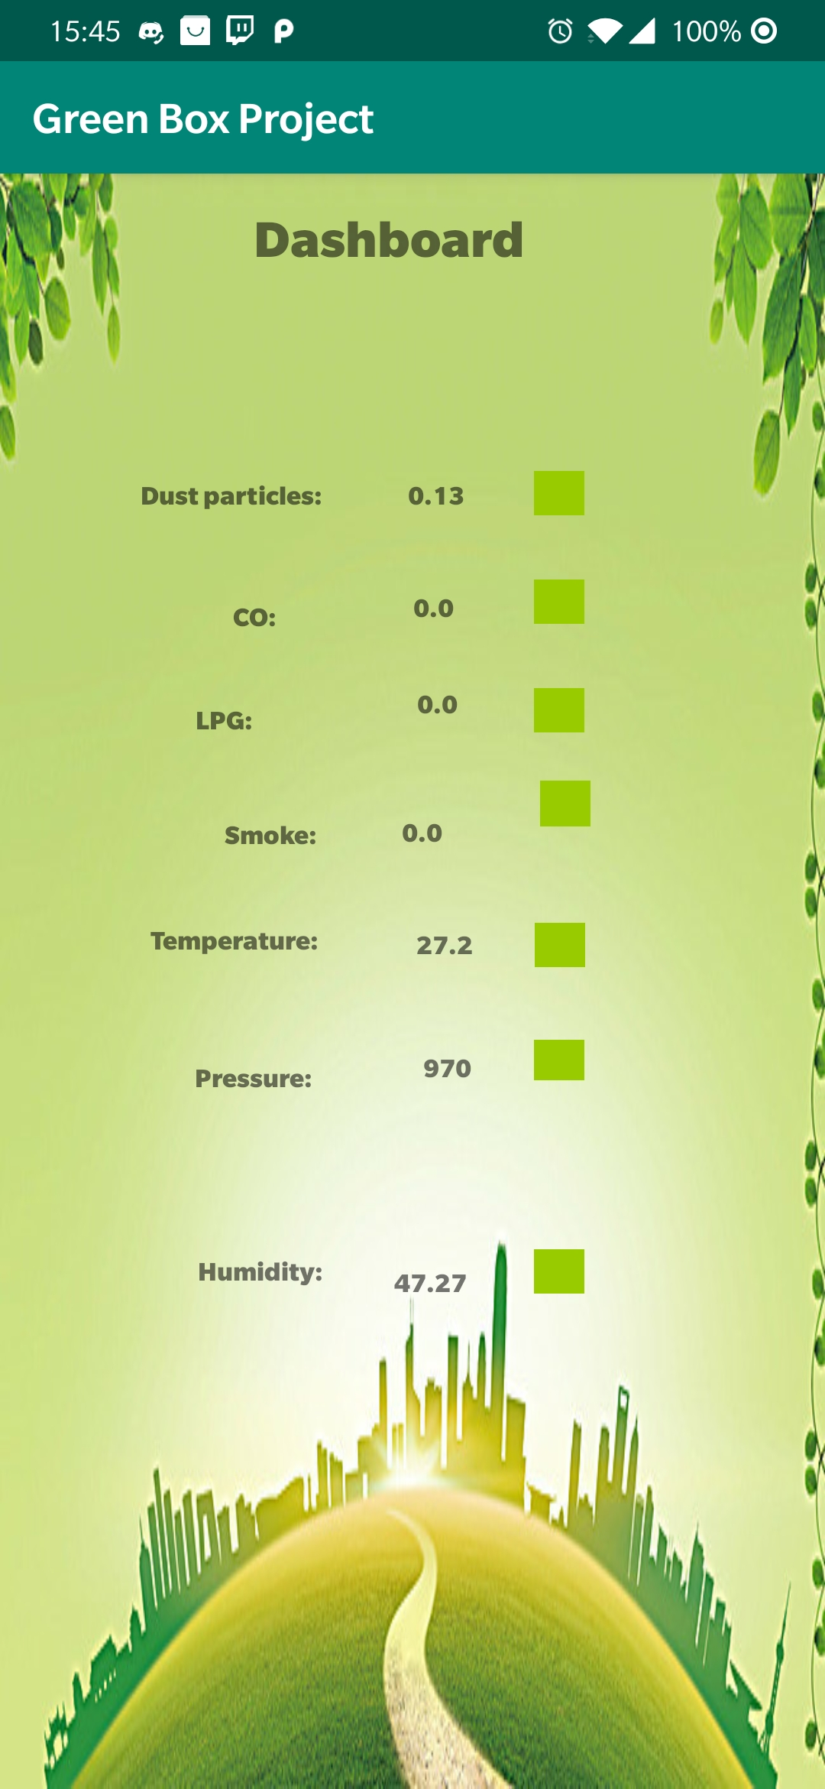
Android App
Real time displays for:
Temperature
Dust Density
Humidity
Carbon Monoxide
Pressure/Altitude
Battery level
LPG
Smoke

Slide 11
LIVE DEMO

Slide 12
Question time

Slide 13
Thank YOU!

